Slide 1

School of Computing Science and Engineering Course Code : BCSE3032 Course Name: SE & TM
COUPLING AND COHESION MEASURES
Coupling: Coupling is also the indication of the relationships between modules. It is concept of Inter-module. Coupling has also many types but usually low coupling is good for software.
Program Name: B.Tech

Slide 2
School of Computing Science and Engineering Course Code : BCSE3032 Course Name: SE & TM
COUPLING AND COHESION MEASURES
Cohesion: Cohesion is the indication of the relationship within module. It is concept of intra-module. Cohesion has many types but usually highly cohesion is good for software.
Program Name: B.Tech

Slide 3
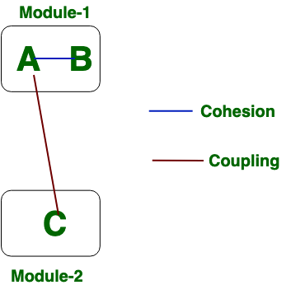
School of Computing Science and Engineering Course Code : BCSE3032 Course Name: SE & TM
COUPLING AND COHESION MEASURES
Program Name: B.Tech

Slide 4
School of Computing Science and Engineering Course Code : BCSE3032 Course Name: SE & TM
COUPLING AND COHESION MEASURES
Cohesion is the concept of intra module. | Coupling is the concept of inter module.
Cohesion represents the relationship within module. | Coupling represents the relationships between modules.
Increasing in cohesion is good for software. | Increasing in coupling is avoided for software.
Cohesion represents the functional strength of modules. | Coupling represents the independence among modules.
Highly cohesive gives the best software. | Where as loosely coupling gives the best software.
In cohesion, module focuses on the single thing. | In coupling, modules are connected to the other modules.
Program Name: B.Tech

Slide 5
School of Computing Science and Engineering Course Code : BCSE3032 Course Name: SE & TM
COUPLING
Definition
The degree to which all elements of a component are directed towards a single task.
The degree to which all elements directed towards a task are contained in a single component.
The degree to which all responsibilities of a single class are related.
Program Name: B.Tech

Slide 6
Coincidental Cohesion
Functional
Sequential
Communicational
Procedural
Temporal
Logical
Coincidental
Def: Parts of the component are unrelated (unrelated functions, processes, or data)
Parts of the component are only related by their location in source code.
Elements needed to achieve some functionality are scattered throughout the system.
Accidental
Worst form
6
Program Name: B.Tech

Slide 7
Example
Print next line
Reverse string of characters in second argument
Add 7 to 5th argument
Convert 4th argument to float
7
Program Name: B.Tech

Slide 8
Logical Cohesion
Functional
Sequential
Communicational
Procedural
Temporal
Logical
Coincidental
Def: Elements of component are related logically and not functionally.
Several logically related elements are in the same component and one of the elements is selected by the client component.
8
Program Name: B.Tech

Slide 9
Example
A component reads inputs from tape, disk, and network.
All the code for these functions are in the same component.
Operations are related, but the functions are significantly different.
Improvement?
9
Program Name: B.Tech

Slide 10
Temporal Cohesion
Functional
Sequential
Communicational
Procedural
Temporal
Logical
Coincidental
Def: Elements are related by timing involved
Elements are grouped by when they are processed.
Example: An exception handler that
Closes all open files
Creates an error log
Notifies user
Lots of different activities occur, all at same time
10
Program Name: B.Tech

Slide 11
Example
A system initialization routine: this routine contains all of the code for initializing all of the parts of the system. Lots of different activities occur, all at init time.
Improvement?
11
Program Name: B.Tech

Slide 12
Procedural Cohesion
Functional
Sequential
Communicational
Procedural
Temporal
Logical
Coincidental
Def: Elements of a component are related only to ensure a particular order of execution.
Actions are still weakly connected and unlikely to be reusable.
Example:
...
Write output record
Read new input record
Pad input with spaces
Return new record
...
12

Slide 13
Communicational Cohesion
Functional
Sequential
Communicational
Procedural
Temporal
Logical
Coincidental
Def: Functions performed on the same data or to produce the same data.
Examples:
Update record in data base and send it to the printer
Update a record on a database
Print the record
Fetch unrelated data at the same time.
To minimize disk access
13
Program Name: B.Tech

Slide 14
Sequential Cohesion
Functional
Sequential
Communicational
Procedural
Temporal
Logical
Coincidental
Def: The output of one part is the input to another.
Data flows between parts (different from procedural cohesion)
Occurs naturally in functional programming languages
Good situation
14
Program Name: B.Tech

Slide 15
Functional Cohesion
Functional
Sequential
Communicational
Procedural
Temporal
Logical
Coincidental
Def: Every essential element to a single computation is contained in the component.
Every element in the component is essential to the computation.
Ideal situation
What is a functionally cohesive component?
One that not only performs the task for which it was designed but
it performs only that function and nothing else.
15
Program Name: B.Tech

Slide 16
Examples of Cohesion
Function A
Function A
Function A’
Function A’’
Time t₀
Time t₀ + X
Time t₀ + 2X
Function
B
Function
C
logic
Function
D
Function
E
Coincidental
Parts unrelated
Logical
Similar functions
Temporal
Related by time
Function A
Function B
Function C
Procedural
Related by order of functions
16
Program Name: B.Tech

Slide 17
Examples of Cohesion (Cont.)
Function A
Function B
Function C
Function A
Function B
Function C
Communicational
Access same data
Sequential
Output of one is input to another
Function A part 1
Function A part 2
Function A part 3
Functional
Sequential with complete, related functions
17
Program Name: B.Tech

Slide 18
Exercise: Cohesion for Each Module?
Compute average daily temperatures at various sites
Initialize sums and open files
Create new temperature record
Store temperature record
Close files and print average temperatures
Read in site, time, and temperature
Store record for specific site
Edit site, time, or temperature field
Functional
Sequential
Communicational
Procedural
Temporal
Logical
Coincidental
18
Program Name: B.Tech

Slide 19
Outline
Cohesion
Coupling
Program Name: B.Tech

Slide 20
Coupling
The degree of dependence such as the amount of interactions among components
No dependencies
Loosely coupled
some dependencies
Highly coupled
many dependencies
Program Name: B.Tech

Slide 21
Coupling
The degree of dependence such as the amount of interactions among components
How can you tell if two components are coupled?
(In pairs, 2 minutes)
Program Name: B.Tech

Slide 22
Type of Coupling
High Coupling
Content
Common
External
Control
Stamp
Data
Uncoupled
Avoid
Loose
Try to achieve
Low
22
Program Name: B.Tech

Slide 23
Content Coupling
Content
Common
External
Control
Stamp
Data
Uncoupled
Def: One component modifies another.
Example:
Component directly modifies another’s data
Component modifies another’s code, e.g., jumps (goto) into the middle of a routine
Question
Language features allowing this?
23
Program Name: B.Tech

Slide 24
Example
Part of a program handles lookup for customer.
When customer not found, component adds customer by directly modifying the contents of the data structure containing customer data.
Improvement?
24
Program Name: B.Tech

Slide 25
Common Coupling
Content
Common
External
Control
Stamp
Data
Uncoupled
Def: More than one component share data such as global data structures
Usually a poor design choice because
Lack of clear responsibility for the data
Reduces readability
Difficult to determine all the components that affect a data element (reduces maintainability)
Difficult to reuse components
Reduces ability to control data accesses
25
Program Name: B.Tech

Slide 26
Example
Process control component maintains current data about state of operation. Gets data from multiple sources. Supplies data to multiple sinks. Each source process writes directly to global data store. Each sink process reads directly from global data store.
Improvement?
26
Program Name: B.Tech

Slide 27
External Coupling
Content
Common
External
Control
Stamp
Data
Uncoupled
Def: Two components share something externally imposed, e.g.,
External file
Device interface
Protocol
Data format
Improvement?
Notes:
27

Slide 28
Control Coupling
Content
Common
External
Control
Stamp
Data
Uncoupled
Def: Component passes control parameters to coupled components.
May be either good or bad, depending on situation.
Bad if parameters indicate completely different behavior
Good if parameters allow factoring and reuse of functionality
Good example: sort that takes a comparison function as an argument.
The sort function is clearly defined: return a list in sorted order, where sorted is determined by a parameter.
28
Program Name: B.Tech

Slide 29
Stamp Coupling
Content
Common
External
Control
Stamp
Data
Uncoupled
Def: Component passes a data structure to another component that does not have access to the entire structure.
Requires second component to know how to manipulate the data structure (e.g., needs to know about implementation).
The second has access to more information that it needs.
May be necessary due to efficiency factors: this is a choice made by insightful designer, not lazy programmer.
29
Program Name: B.Tech
Notes:
.

Slide 30
Example
Customer Billing System
The print routine of the customer billing accepts customer data structure as an argument, parses it, and prints the name, address, and billing information.
Improvement?
30
Program Name: B.Tech

Slide 31
Improvement --- OO Solution
Use an interface to limit access from clients
Customer
get name get address get billing info get other info …
?
void print (Customer c) { … }
Program Name: B.Tech

Slide 32
Data Coupling
Content
Common
External
Control
Stamp
Data
Uncoupled
Def: Component passes data (not data structures) to another component.
Every argument is simple argument or data structure in which all elements are used
Good, if it can be achieved.
Example: Customer billing system
The print routine takes the customer name, address, and billing information as arguments.
32
Program Name: B.Tech

Slide 33
Uncoupled
Content
Common
External
Control
Stamp
Data
Uncoupled
Content
Common
Control
Stamp
Data
Uncoupled
Completely uncoupled components are not systems.
Systems are made of interacting components.

Slide 34
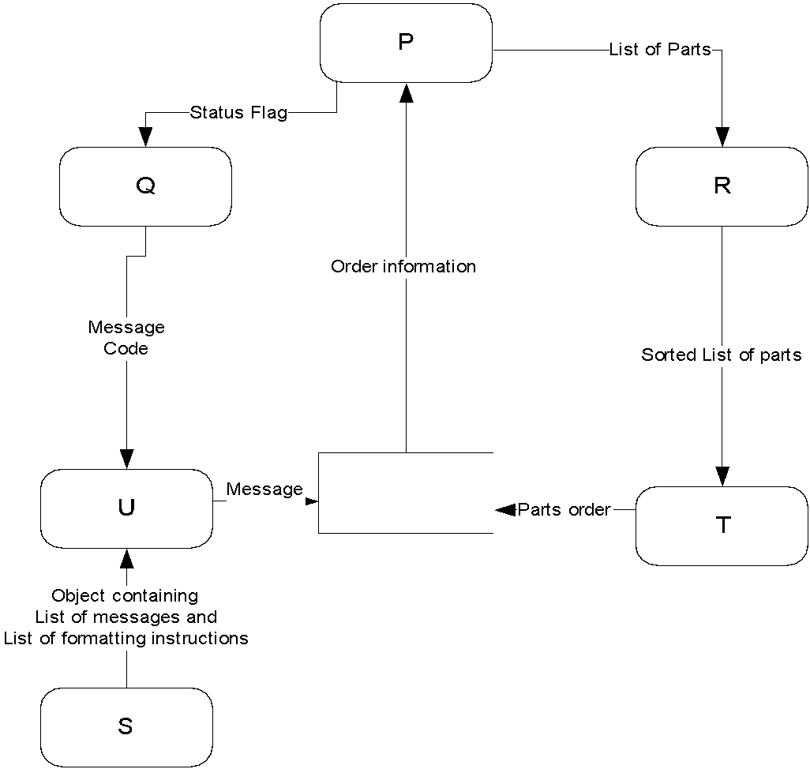
Exercise: Define Coupling between Pairs of Modules
Content
Common
External
Control
Stamp
Data
Uncoupled
Program Name: B.Tech

